Slide 1

Create your own Customer Journey Map
Go back to Miro.com
Use the Customer Journey Map template
Think of 1 Key Process that each of your personas go through to make a purchase
Identify the various opportunities at each touchpoint and share with us what you plan to do with them

Slide 2
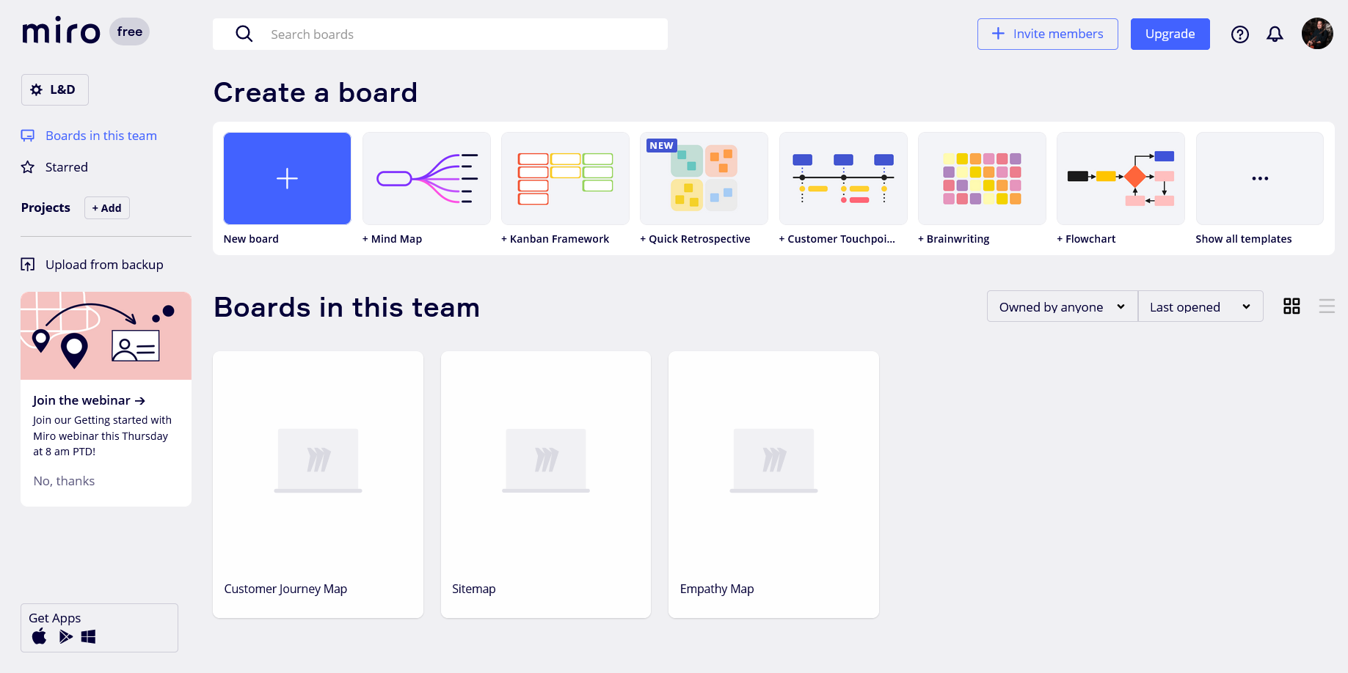
2) From your Dashboard, select Show all Templates

Slide 3
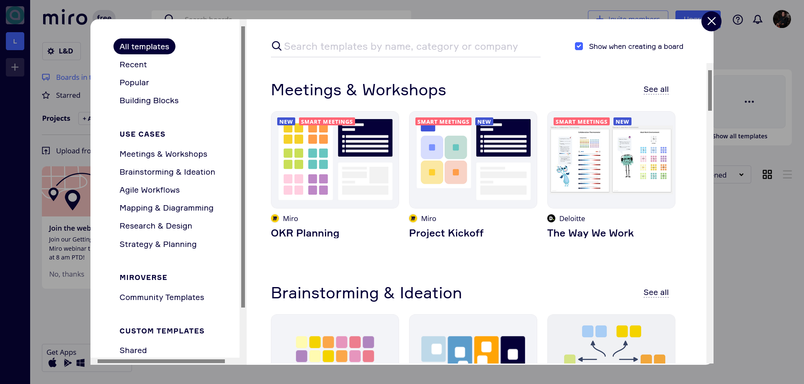
2) Enter Customer Journey Map into Search

Slide 4
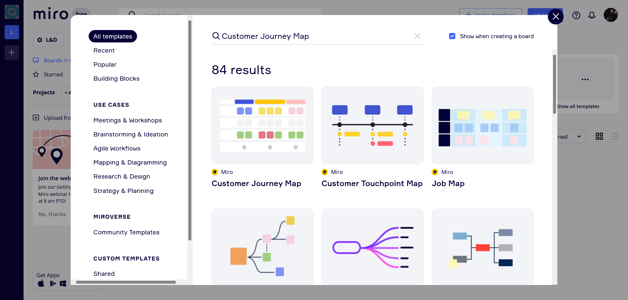
Click on the Customer Journey Map Template

